Slide 1

Is a college education a good value?

Slide 2
Strategy
Collect information on:
Student loans
Salary based on education and location
Compare and contrast the expected salary based on state of residence
Is a college education a good investment?
Are there some majors that are a better investment than others?
Are there some locations where an education is a better investments?
Introduce tool to determine WHEN a college education starts to pay off.

Slide 3
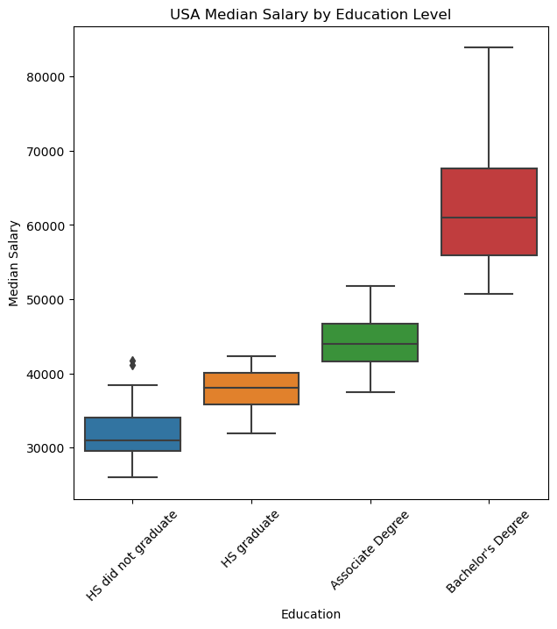
Median salary increases based on education.
Does this trend hold true everywhere in the United States?

Slide 4
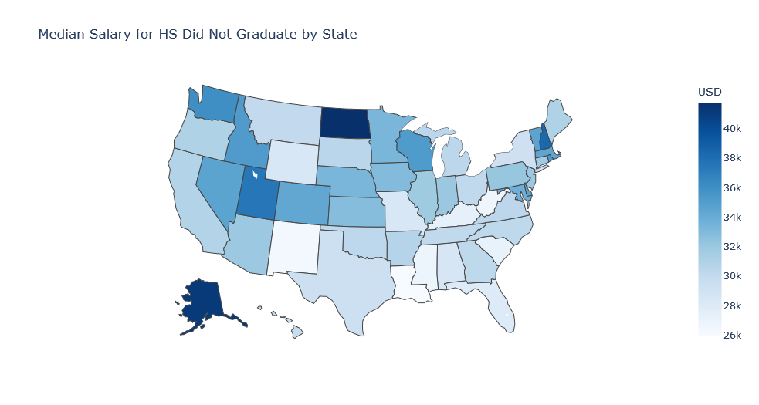
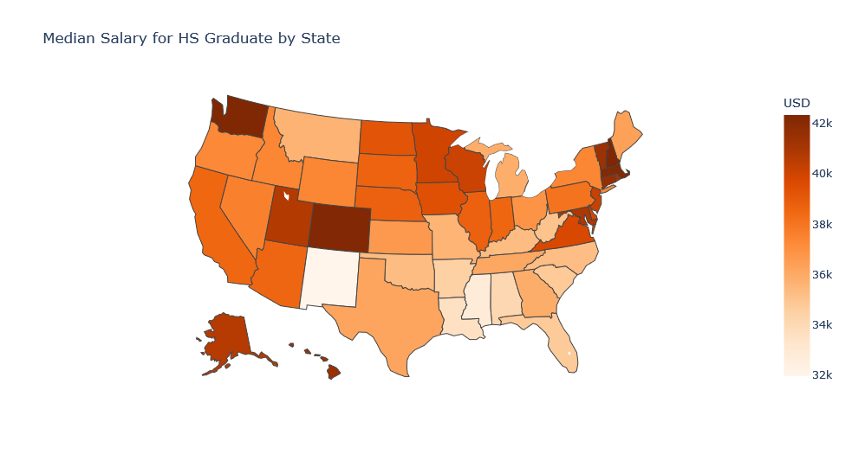
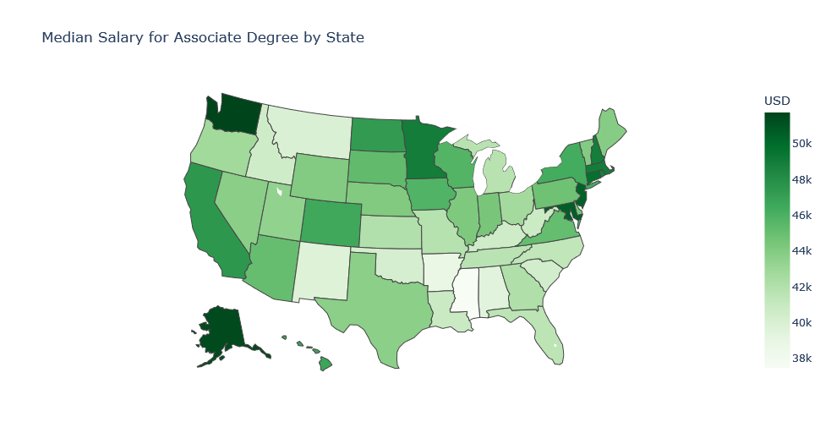
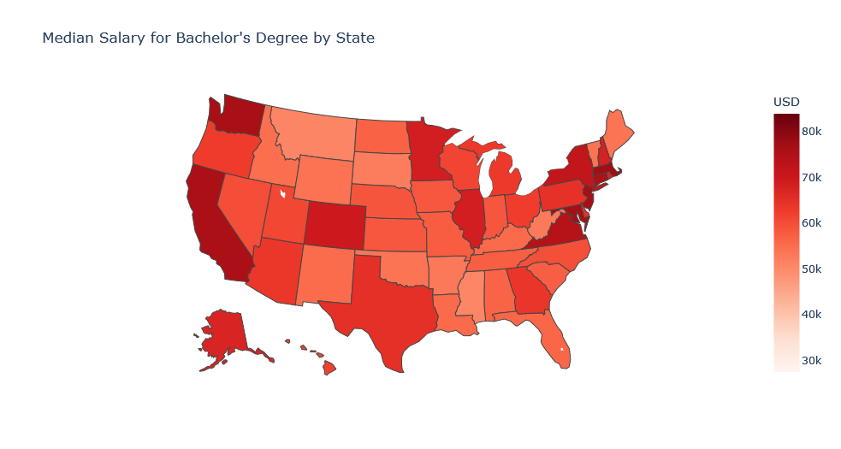

Slide 5
Does your choice of major matter?

Slide 6
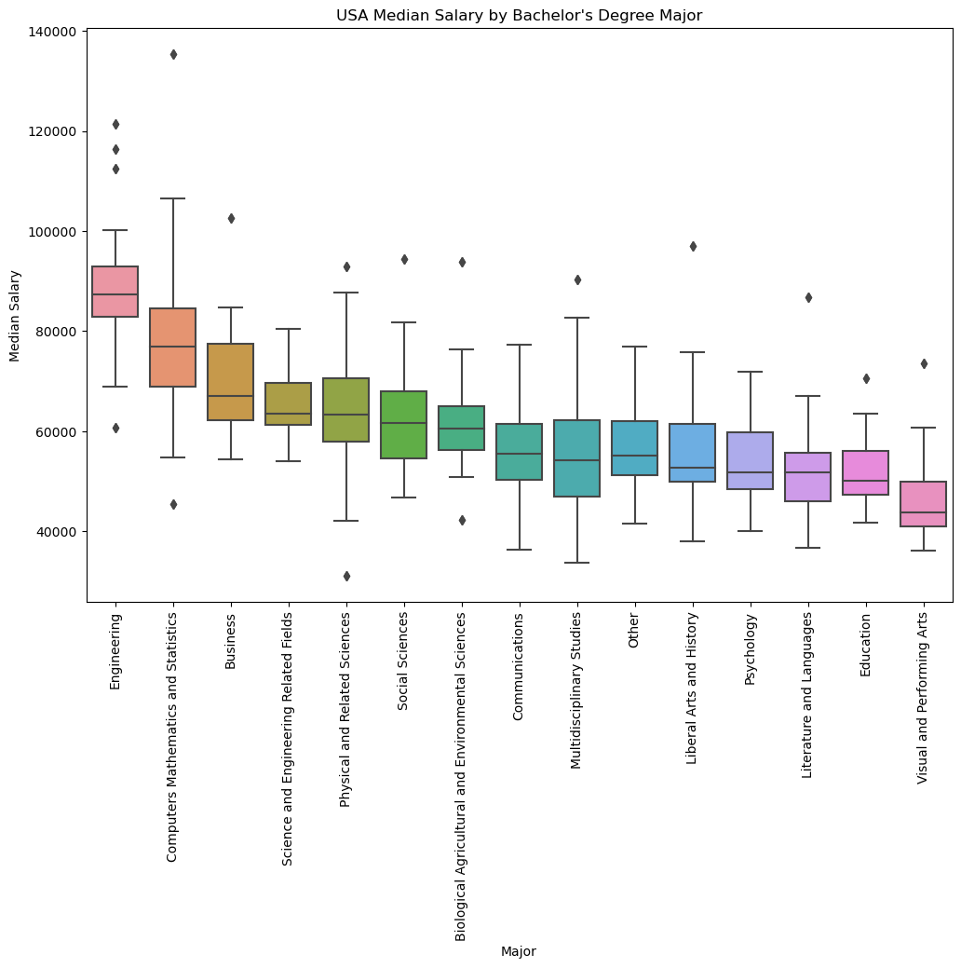
There are a few outliers in terms of education and salary.

